Slide 1
Digital Portfolio
STUDENT NAME: S.GEETHA PRIYA
REGISTER NO AND NMID: 222407886 AND autunm1455ds242727
DEPARTMENT: BSC(CS WITH DS)
COLLEGE: COLLEGE/ UNIVERSITY

Slide 2
PROJECT TITLE
Smart Digital Portfolio Website
Tagline: “Your Resume , Reinvented-Go Digital,
Go professional!”
(Also add your Name, Reg No , Department , College here)

Slide 3

AGENDA
Problem Statement
Project Overview
End Users
Tools and Technologies
Portfolio design and Layout
Features and Functionality
Results and Screenshots
Conclusion
9.GitHub Link
3/21/2024 Annual Review

Slide 4

PROBLEM STATEMENT
X Paper resumes are outdated , static , and limited.
Hard to update
Fail to engage recruiters
Cannot showcase projects or creativity
A modern solution is needed to display skills dynamically.

Slide 5

PROJECT OVERVIEW
A Digital Portfolio Website that acts as an online resume.
Showcases About Me , Skills , Projects , Achievements
Fully responsive & interactive
Builds a professional online brand for placements

Slide 6

WHO ARE THE END USERS?
Built for dreamers , designed for achievers
Student & Freshers -> to showcase their talent
Recruiters & Employers -> to quickly view candidate profile
colleges -> to support placement drives and career training

Slide 7

TOOLS AND TECHNIQUES
Simple tools , powerful results:
Fronted: HTML , CSS , JavaScript
Backend(Optional): python Flask / Node.js
Database: MySQL / SQLite
Hosting: GitHub Pages /CodePen
Version Control : GitHub

Slide 8
POTFOLIO DESIGN AND LAYOUT
Clean , Simple , Professional.
Home Page -> About Me +Contact
Skill Page -> Technical &Soft Skills
Project Page -> Screenshots +GitHub Links
Certificates Page -> Achievements
Contact Form -> Easy recruiter communication
8

Slide 9
FEATURES AND FUNCTIONALITY
More than a resume , it’s your personal brand online.
Responsive design(mobile + desktop)
Live project showcase with GitHub links
Contact form with email integration
Easy updates for new skills /certificates

Slide 10
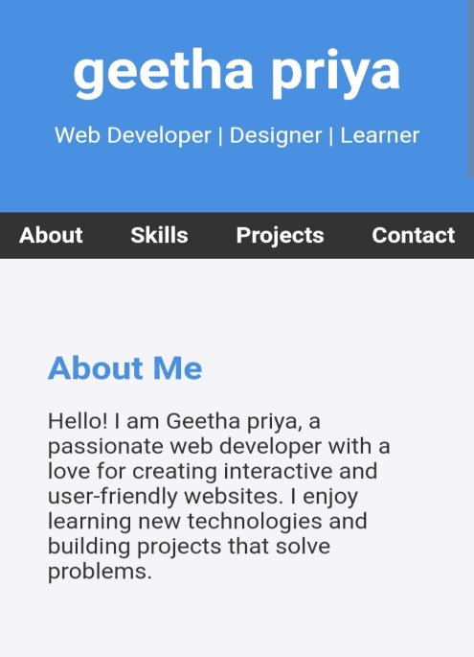
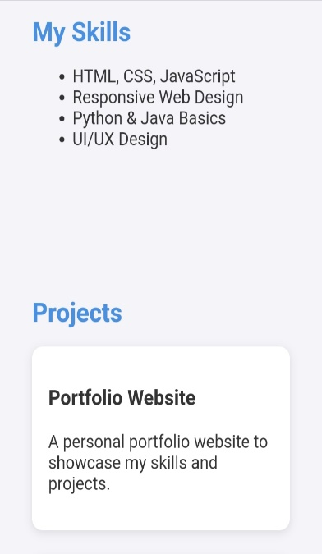
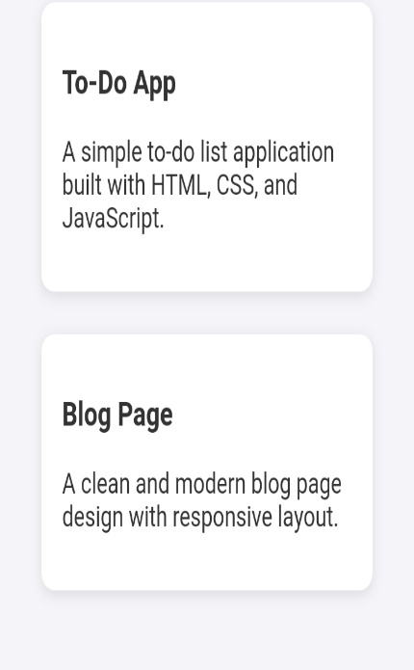
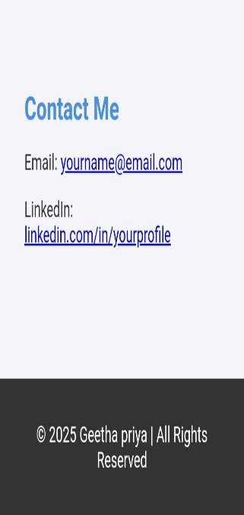

RESULTS AND SCREENSHOTS
Results:
About Me: Built a professional intro page that presents my identity and goals
Skills: Highlighted technical expertise for quick recruiter review.
Projects: Showcased real-world applications proving coding ability.
Contact: Enable easy networking through email and LinkedIn
3/21/2024 Annual Review
10

Slide 11
CONCLUSION
The future of resumes is digital.
Builds professional online presence
Makes students stand out in placements
Future-ready career solution
11

